Slide 1
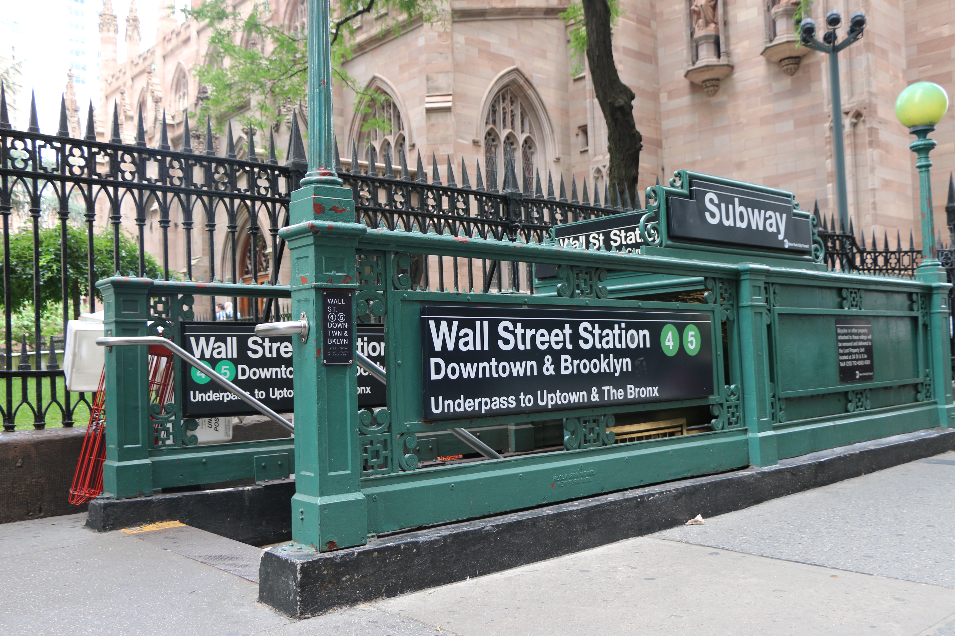
Introduction to Financial Modeling

Slide 2
Objectives For This Session Scraping the surface of modeling
Provide a high-level understanding of financial modeling.
Learn how to adjust a dynamic model to create an earnings forecast based on altered model inputs.
Give you an example model (Starbucks) to experiment with.

Slide 3
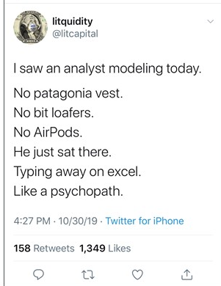
Introduction to Financial Modeling Agenda
Background information about financial modeling in general
An overview of the model we will use for our demonstration
The model is designed to forecast results for Starbucks Corp (SBUX)
The equations are setup to capture the primary links between the financial statements, and
Considers the metrics management uses to analyze their results.
Model Demonstration
Start with high-level review of the model
Adjust the inputs to calibrate the model to meet management’s guidance

Slide 4
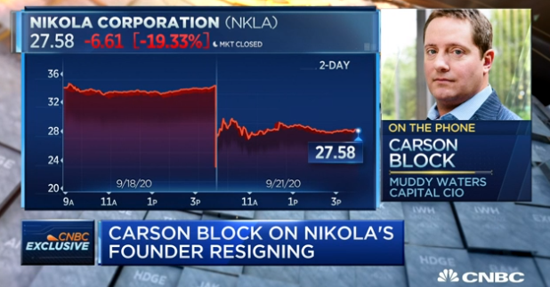
I. Background Information What is a model?
The term “model” describes different tools depending on the context in which it is used.
For the purpose of an equity research model, we are describing a financial scenario for a specific company (output), based on a collection of forecast opinions (inputs).
A sell-side analyst’s model output typically takes the form of the three primary financial statements (Income Statement, Balance Sheet, and Cash Flow Statement).
An earnings model should be dynamic, meaning any of the key inputs can be changed to calculate a new forecast scenario.
The overarching idea is to have a reasonable basis for your forecast or investment recommendations
Keep this in mind when you are pitching stocks. Everyone understands the limitations of forecasting.
Discuss an example from a professional analyst
Carson Block calls sell-side analysts “dating service for institutional investors” should be “taken as seriously as a 5-year-old kid” (starts at 3:34)

Slide 5
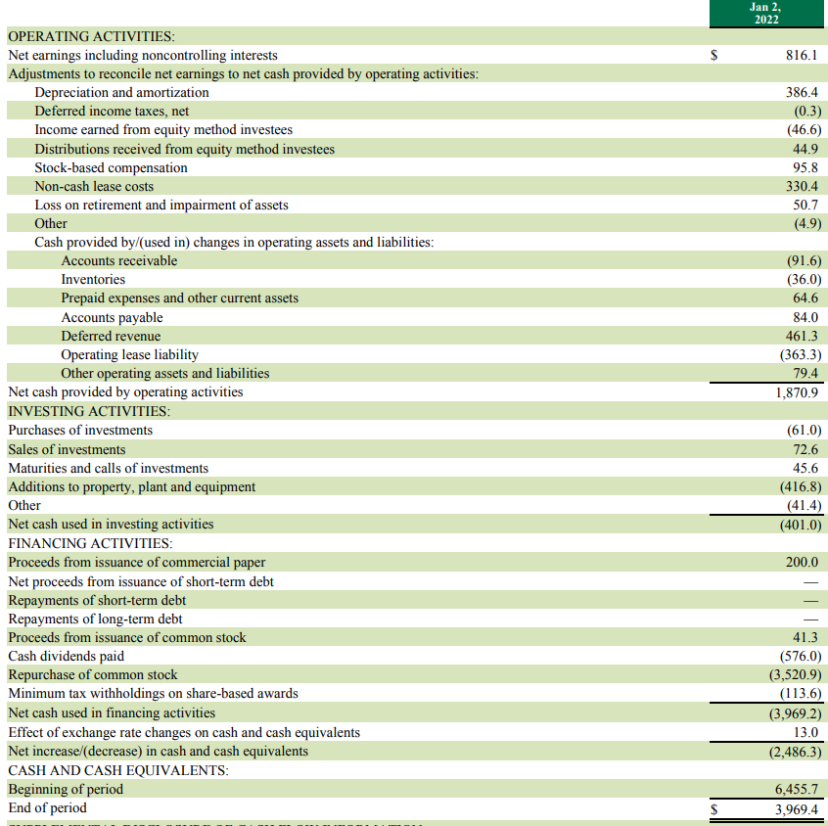
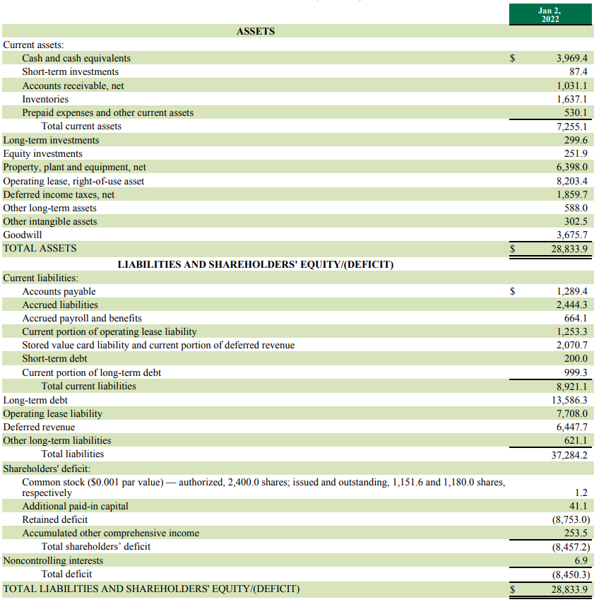
II. Overview of the SBUX Model The links between the financials
Notes:
The point here is to communicate at a high-level how the model was created without getting lost in the detail of the spreadsheet.

Slide 6
II. Overview of the SBUX Model The links between the financials
Primary links between the Income Statement and Balance Sheet:
Interest income is calculated based on the balances of the investment accounts on the Balance Sheet.
Interest expense is calculated using the debt forecast on the Balance Sheet.
Depreciation is modeled on the Balance Sheet as part of the PP&E calculation and allocated to segments.
Net income from the Income Statement flows through retained earnings (equity section of the Balance Sheet).
Primary links between the Income Statement and Cash Flow Statement:
Net income from the Income Statement is the starting point for the Cash Flow Statement.
Depreciation expense is reversed from net income as a non-cash expense on the Cash Flow Statement
Notes:
The point here is to communicate at a high-level how the model was created without getting lost in the detail of the spreadsheet.
The intention is not to go through each of these points, but to have them here for reference.

Slide 7
II. Overview of the SBUX Model The links between the financials (Cont.)
Primary links between the Balance Sheet and Cash Flow Statement:
Depreciation is modeled on the Balance Sheet as part of PP&E, reversed as a non-cash item on the Cash Flow Statement.
Changes in all other non-cash balances from the Balance Sheet are adjusted from net income on the Cash Flow Statement.
Changes in all operating assets (i.e., receivables, payables, inventory, etc.) are reported on the Cash Flow Statement.
Capital expenditures are modeled on the Cash Flow Statement and reflected in the PP&E balance on the Balance Sheet.
Changes in all other investing related balances from the Balance Sheet are reflected on the Cash Flow Statement.
Changes in debt from the Balance Sheet are captured on the Cash Flow Statement in the financing activity section.
Stock-based compensation is modeled on the Cash Flow Statement and flows through the equity section of the Balance Sheet.
Dividends and share repurchases are included in the Cash Flow Statement and flow through equity on the Balance Sheet.
The ending cash balance from the Cash Flow Statement becomes the cash balance reported on the Balance Sheet.

Slide 8
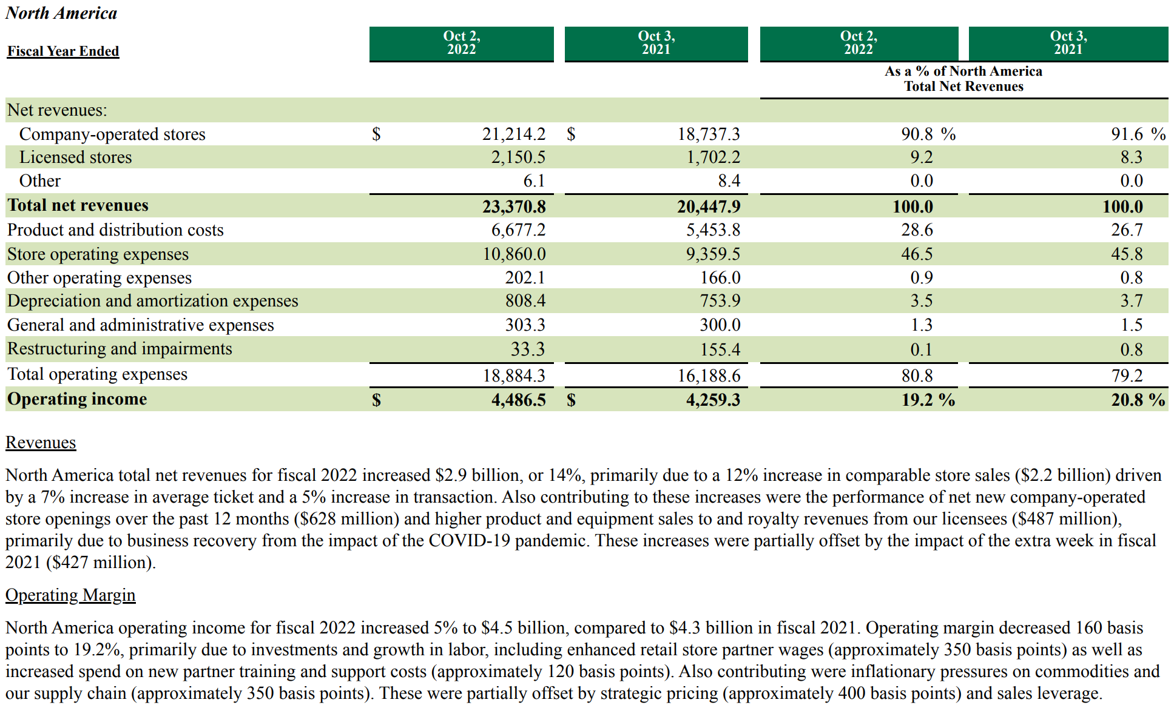
II. Overview of the SBUX Model How management analyzes results
Based on segments.
Separate results by:
Company-operated stores, and
Licensed stores
Revenue:
Average revenue per store (comp sales)
New store openings
Operating expenses as % of revenue.

Slide 9
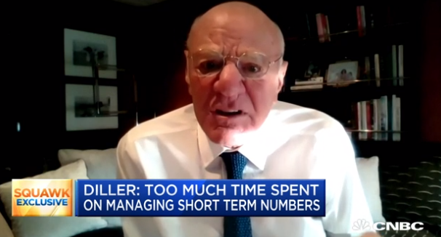
III. Model Demonstration Let’s do some modeling!
Open the Starbucks model…Get comfortable with the layout.
What inputs do we need to change to calibrate our forecast to meet management’s guidance?
https://investor.starbucks.com/financial-data/targets/default.aspx
Let’s adjust the forecast together for fiscal 2023
For revenue and operating expenses: Focus on the North America Segment only
Discuss limitations in comp store sales
Focus on store counts and revenue growth rates
Barry Diller on Management guidance “keeps companies doing dumbass work”

Slide 10
III. For More Advanced Modelers A fun exercise across the financials
Consider the long-term (2025) guidance management provided at the last Investor Day:
“Next, we remain committed to sustaining an incredibly compelling dividend, continuing to target an earnings payout ratio of approximately 50%, which equates to an estimated yield of about 2%. Now both our payout and our estimated yield are near the top-end of growth companies of our size and scale creating superior shareholder returns when you combine it with the rate of our earnings growth. We will resume our share buyback program, reinstituting a healthy level of return of shareholder capital. We expect to yield a benefit of approximately 1% on earnings net of interest – incremental interest expense beginning in fiscal year 2024, as we expect the reinvention plans to help uplift our free cash flow and our debt capacity while we maintain our long-term leverage target of three times lease adjusted EBITDA, which is consistent with an investment-grade credit rating of BBB+. Now, between our dividends and our share buybacks, we expect to return approximately $20 billion to shareholders in the next three years.”
-Rachel Ruggeri (Starbucks CFO) Investor Day, September 13, 2022.

Slide 11
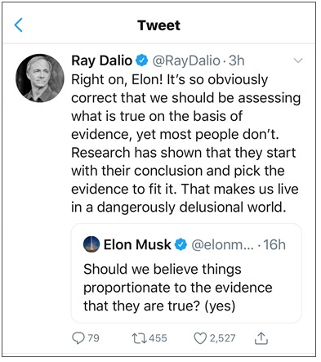
III. For More Advanced Modelers A fun exercise across the financials
Consider how management’s comments are interrelated:
The dividend payout will depend on the EPS forecast
Dividends will contribute to the total cash returned to shareholders
At the midpoint of the EPS range dividends would represent about $8B of the $20B in cash returned (leaving $12B in repurchases).
What price assumption would you use for share repurchases?
The dividend yield of 2% should give a clue to the price management is expecting.
Would the impact of your share repurchase assumptions exceed the expected 1% benefit for EPS after considering incremental interest?
Will you run out of cash?
Your forecast should provide liquidity for operations, capital expenditures, dividend payments and share repurchases.
What is your capex forecast?
Did you consider management’s target debt level?
These questions are the reason we build dynamic models covering all three financial statements which can incorporate several different interrelated assumptions at one time.

Slide 12
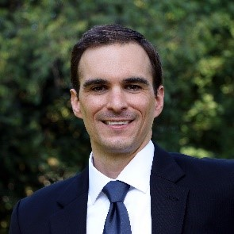
My Background “Pay no attention to the man behind the curtain”
I have spent the last 15 years analyzing companies in various capacities. After earning a BSBA in Finance, MS in Accounting and MBA from Northeastern University, I began my professional career at PricewaterhouseCoopers (PwC) in New York as an Assurance Associate in the Financial Services practice. At PwC, I participated in a rotational assignment within the Financial Service Research Institute studying the bank mergers of the 2008 financial crisis, drawing on my previous experience as a bank examiner
with the Federal Deposit Insurance Corporation (FDIC).
After PwC, I spent five years at UBS where I worked first as a Capital Specialist, and then as an Equity Research Associate. In my research role I built and maintained earnings models, contributed to research reports, and participated in client conferences, covering the Semiconductor and Semiconductor Capital Equipment Industries. I then moved to General Electric Capital Corp in 2014 as a Risk Analyst where I built regression models to predict asset losses based on various macroeconomic scenarios. After the sale of most of GE Capital’s assets, I started a consulting firm which provides capital planning support to banks, in addition to running Gutenberg Research, a financial modeling community.

Slide 13
© Gutenberg Research LLC 2023. All Rights Reserved.

